Slide 1
Elementary Data Structures

Slide 2
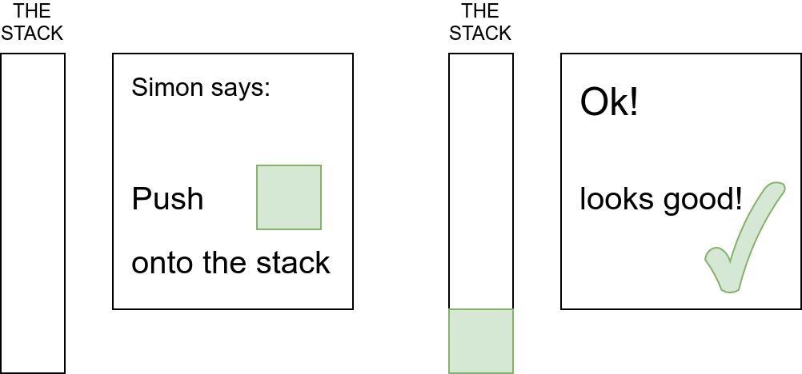
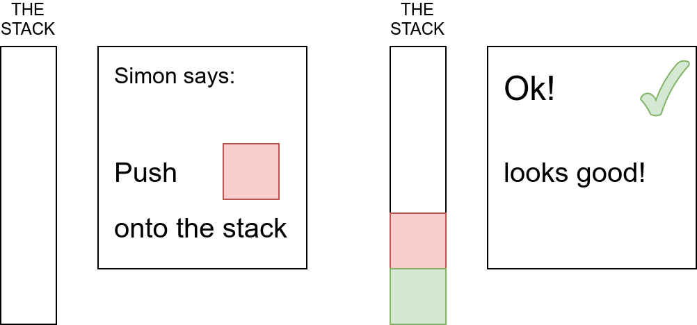
Stacks

Slide 3
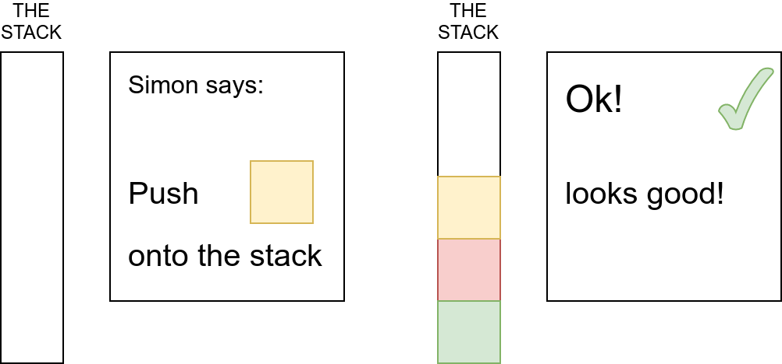
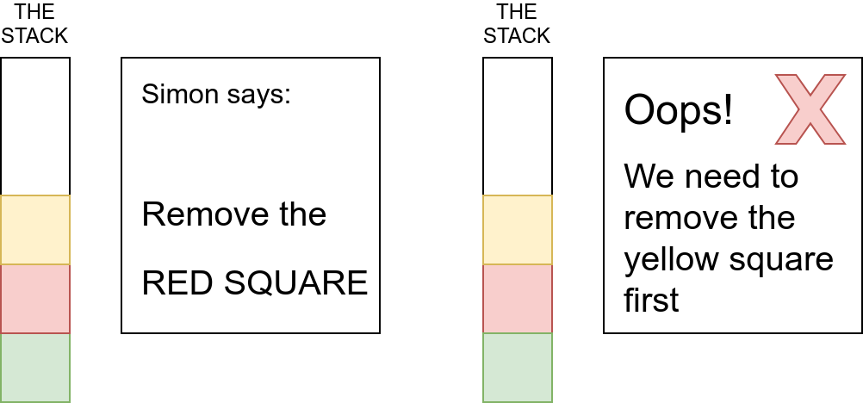
Stacks Continued

Slide 4
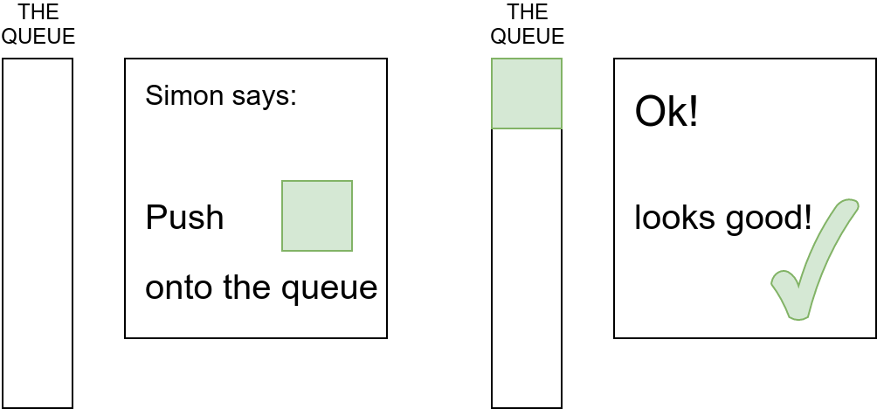
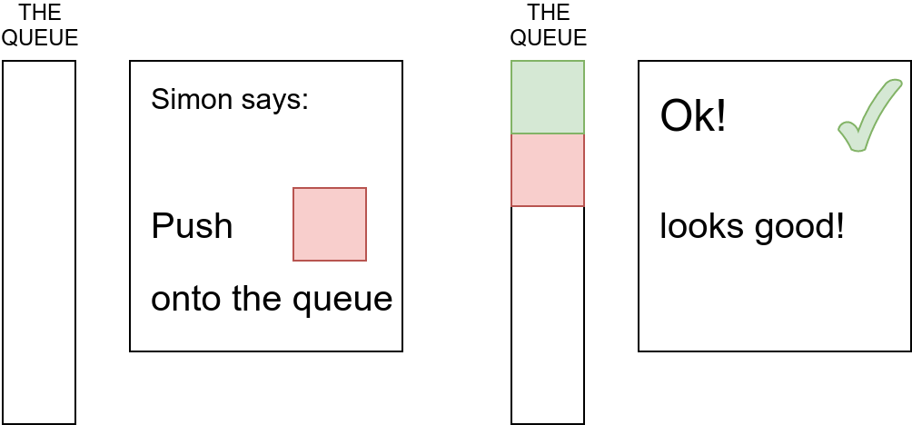
Queues

Slide 5
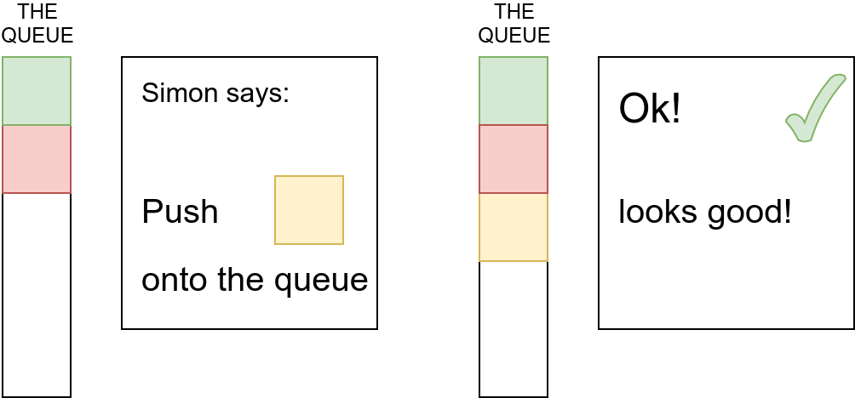
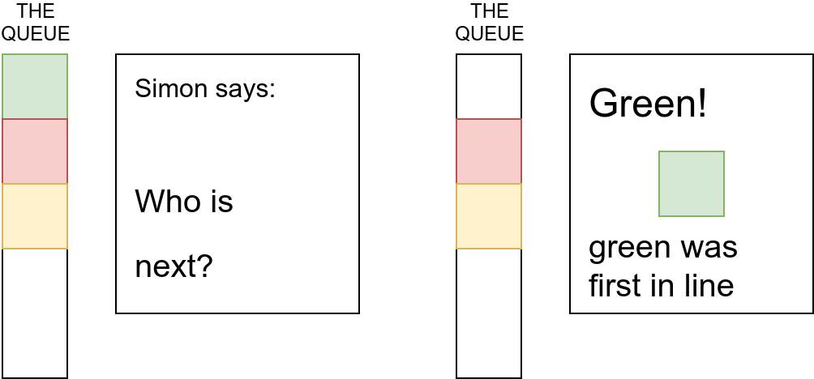
Queues Continued

Slide 6
Arrays
In a computer’s memory, it’s common to store data of the same type side-by-side.
0
1
2
3
4
5
6
7
Position
s
h
a
m
e
0
0
0
Value
What a shame!
Don’t worry - we’ll fix that!

Slide 7
Arrays continued...
To remove elements from an array, it is often necessary to shift everything else back into place.
For example, to remove “s” we simply move everything one cell back and then delete the last element
0
1
2
3
4
5
6
7
Position
0
1
2
3
4
5
6
7
Position
h
h
a
m
e
0
0
0
Value
h
a
a
m
e
0
0
0
Value
0
1
2
3
4
5
6
7
Position
0
1
2
3
4
5
6
7
Position
h
a
m
m
e
0
0
0
Value
h
a
m
e
0
0
0
0
Value

Slide 8
If we write a zero over the “e”, it says ham now.
Fixed it!
0
1
2
3
4
5
6
7
Position
h
a
m
0
0
0
0
0
Value

Slide 9
Arrays continued
When inserting an item into the middle of an array, it is always necessary to shift all of the items to make room!
This makes arrays inefficient for some uses.
Fortunately, there’s a solution!
0
1
2
3
4
0
1
2
3
4
0
1
2
3
4
0
1
2
3
4
A
B
D
E
A
B
D
D
E
A
B
D
E
A
B
C
D
E

Slide 10
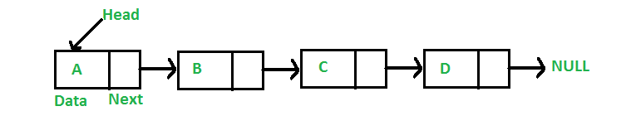
Linked Lists
“B” is located at
Position 3
0
1
2
3
4
5
6
7
8
9
10
11
Position
A
3
B
6
D
9
E
Value
This is called
a “node”
In a linked list, each location stores a value, and also the location of the next value.
3 is the position that comes after “A”

Slide 11
Linked Lists Continued
It’s okay to add C here;
no need to shift anything!
Let’s add “C” to the list!
S
0
1
2
3
4
5
6
7
8
9
10
11
12
13
14
A
3
B
6
D
9
E
C
0
1
2
3
4
5
6
7
8
9
10
11
12
13
14
“C” comes after “B”,
So update node B
A
3
B
12
D
9
E
C
0
1
2
3
4
5
6
7
8
9
10
11
12
13
14
“D” comes after “C”,
So update node C
A
3
B
6
D
9
E
C
6
Follow the pointers!
You should be able to read “A B C D E”

Slide 12
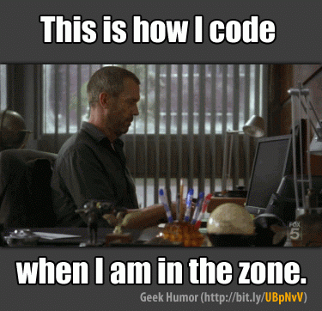
Exercises

